Slide 1

TSA Complaint Data Analysis
DSC640-T301 Data Presentation & Visualization
Joseph Damico

Slide 2

Introduction & Purpose
Introduction This presentation analyzes TSA complaint data to identify trends, patterns, and opportunities for improvement in passenger experience and security processes.
Purpose To provide TSA decision-makers with actionable insights into complaint patterns across airports, complaint categories, and time. This analysis will inform targeted improvements in TSA procedures.

Slide 3
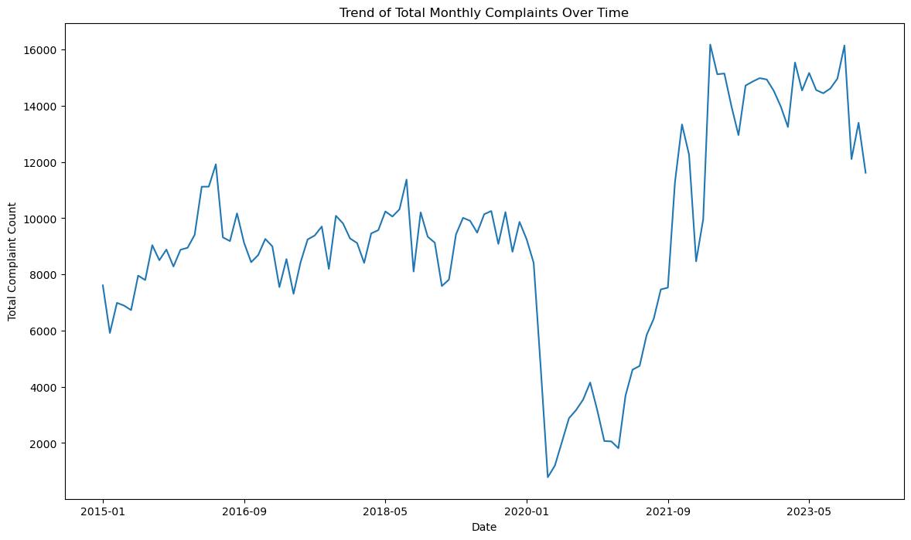
Overview of Data
Data Overview
Data Sources: TSA complaints categorized by airport, complaint type, and subcategory.
Additional geographic information from IATA/ICAO data to map complaint locations.
Time Period: Data spans multiple years, providing a comprehensive view of complaint trends.
Goal Identify key areas and times where complaints are highest to help TSA allocate resources effectively and improve overall passenger satisfaction.

Slide 4
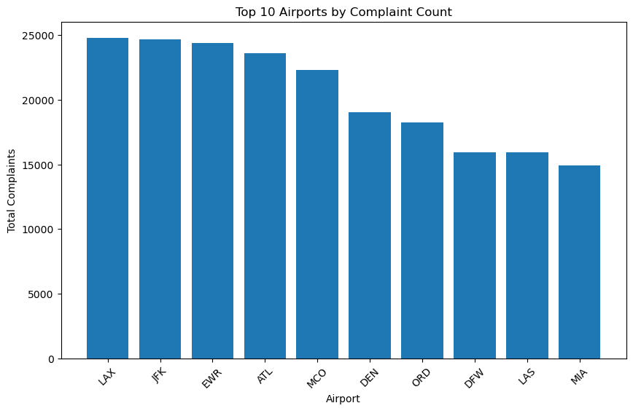
Top Airports by Complaint Count
Top Airports by Complaint Volume The airports with the highest complaint volumes are major national hubs, indicating areas with significant passenger traffic and TSA interactions.
Key Airports
The top 10 airports by complaint volume include LAX, JFK, ATL.
High complaint counts suggest these locations may require targeted improvements in TSA procedures.

Slide 5
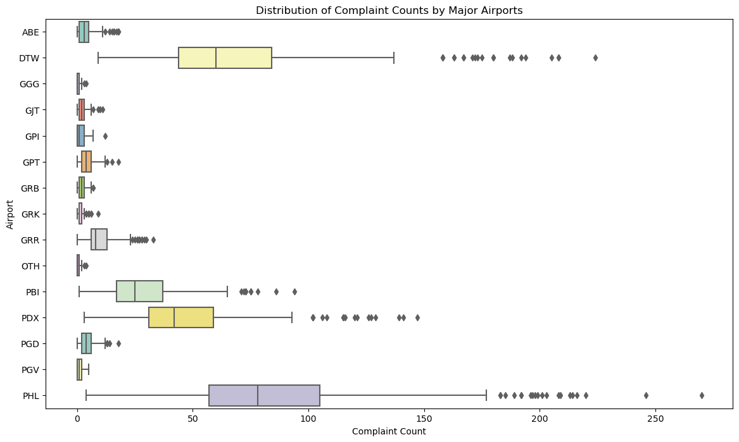
Distribution of Complaint Counts by Major Airports
Complaint Variability by Airport This box plot shows the range and variability of complaints across major airports.
Airports with a wide range of complaints indicate potential operational inconsistencies.
Consistently high-complaint airports may benefit from resource reallocation or process review to manage passenger expectations and reduce complaints.

Slide 6
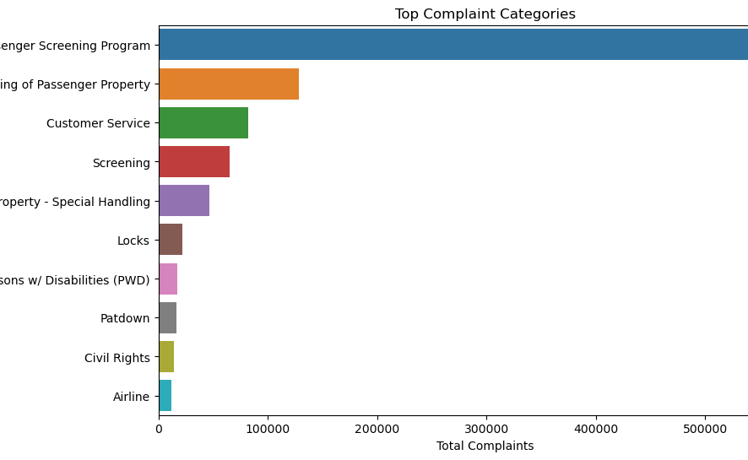
Top Complaint Categories
Top Complaint Categories Certain categories account for a large portion of complaints. Focusing on these areas can improve passenger experience and reduce overall complaint volumes.
Key Categories
The most common complaints are related to Expedited Passenger Screening Program, Property Mishandling, and Customer Service.
Improvements in these areas can have a significant impact on reducing complaints.

Slide 7
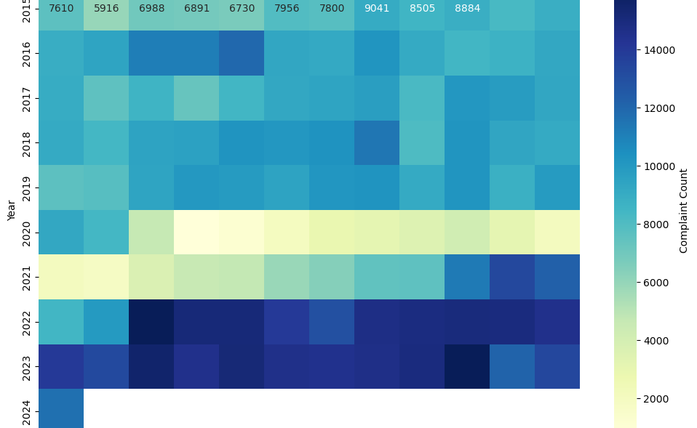
Monthly Complaint Trends
Monthly Trends in Complaint Volume This heatmap displays complaint volumes by month and year, showing trends and seasonal patterns.
Noticeable peaks in certain months suggest that complaint volumes are influenced by seasonal travel trends.
TSA may consider increasing resources or reviewing processes during high-complaint months (e.g., summer and holiday travel periods).

Slide 8
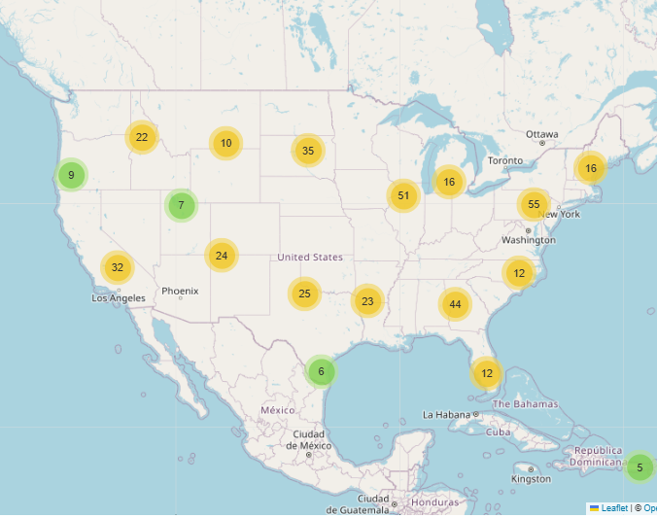
Geographic Distribution of Complaints
This map highlights the geographic distribution of TSA complaints, with larger markers indicating higher complaint volumes.
Major hubs, especially in regions like the Midwest and northeast experience higher complaint rates.
Regional focus on high-complaint areas may allow TSA to address localized issues effectively.

Slide 9
Call to Action
Recommendations Based on the analysis, I recommend the following actions to improve TSA operations and reduce complaints:
Focus on High-Complaint Airports: Concentrate efforts on high-complaint locations such as LAX, JFK, EWR
Address Key Complaint Categories: Improve handling procedures for property and customer service, which account for a large share of complaints.
Prepare for High-Complaint Periods: Allocate additional resources during peak months (e.g., summer and holiday travel seasons) to manage increased passenger volumes.
Objective By implementing these actions, TSA can enhance passenger satisfaction, streamline security processes, and reduce overall complaint volumes.

